Slide 1
CS246: Refresh Policy
Junghoo “John” Cho
UCLA

Slide 2
Ideas?
Q: How can we maintain pages “fresh”? What ideas can we explore to “refresh” pages well?
Idea 1: Some pages change often, some pages do not.
News archive vs daily news article
Q: Can we do things differently depending on how often they change?
Idea 2: A set of pages change together
Java manual pages
Q: Can we do something when we notice that some pages change together?
Q: How can we formalize these ideas as a computational problem?

Slide 3
Idea 1: Leveraging Change Frequencies
Q: What is the idea? How can we formalize the idea?
A: Given different change frequencies of pages, come up with a “refresh policy” that maximizes the “freshness” of our pages
Page refresh policy as optimization problem
Given changes frequencies $λ_{1},λ_{2},…, λ_{n}$of pages $p_{1},p_{2},…, p_{n}$, find a “refresh policy” that maximizes the “freshness” of downloaded pages
Q: What is a “refresh” policy? What does “freshness” mean? What does the change frequency $λ_{i}$ of page $p_{i}$ mean?

Slide 4
Change Metric: Formalizing “Freshness”
Freshness of page $p_{i}$ at time $t$ is: $F\left(p_{i};t\right)= \left\{\begin{matrix}1 if p_{i} is up to date at time t \\ 0 otherwise \end{matrix} \right.$
Freshness of our collection $C$ at time $t$is: $F\left(C;t\right)=\frac{1}{n}\sum_{i=1}^{n}{F(p_{i};t)}$
Q: Why binary metric? Any other way to define “freshness”?
web
collection
p_{i}
p_{i}
...
...

Slide 5
Change Metric: Formalizing “Freshness”
Age of page $p_{i}$ at time $t$ is: $A\left(p_{i};t\right)= \left\{\begin{matrix}0 if p_{i} is up to date at time t \\ (t−modification time) otherwise\end{matrix} \right.$
Age of our collection $C$ at time $t$is: $A\left(C;t\right)=\frac{1}{n}\sum_{i=1}^{n}{A(p_{i};t)}$
Q: But both change over time! What time should we “optimize” for?
web
collection
p_{i}
p_{i}
...
...

Slide 6
Change Metrics Over Time
F(p_{i})
Time averages:
1
$$\overline{F}\left(p_{i}\right)=\lim_{t→∞}{\frac{1}{t}\int_{0}^{t}{F\left(p_{i};t\right)dt}}$$
0
$$\overline{F}\left(C\right)=\lim_{t→∞}{\frac{1}{t}\int_{0}^{t}{F\left(C;t\right)dt}}$$
time
A(p_{i})
$$\overline{A}\left(p_{i}\right)=\lim_{t→∞}{\frac{1}{t}\int_{0}^{t}{A\left(p_{i};t\right)dt}}$$
0
time
$$\overline{A}\left(C\right)=\lim_{t→∞}{\frac{1}{t}\int_{0}^{t}{A\left(C;t\right)dt}}$$
update
refresh

Slide 7
Page Refresh Policy as Optimization Problem
Given changes frequencies $λ_{1},λ_{2},…, λ_{n}$of pages $p_{1},p_{2},…, p_{n}$, find a “refresh policy” that maximizes the freshness (or age) of the collection $C$: $\overline{F}\left(C\right)=\frac{1}{n}\sum_{i=1}^{n}{\overline{F}(p_{i})}$
Q: What does change frequency $λ_{i}$ mean? For example, if $λ_{i}=once/day$, how does the page change? Exactly once a day? At what time? How much predictability? How can we “model” web page changes given $λ_{i}$?

Slide 8
Modeling Page Change
Poisson process with rate λ.
Memoryless, independent
Q: But what do they exactly mean?
Simulating Poisson process
Split time into very small intervals
Flip a coin at each interval with the same probability p: λ ~ p
Under Poisson process with rate $λ$, if $t$ is time to the next event, the p.d.f. of $t$ is: $f(t)={λe}^{−λt} (t>0)$
Q: Is this really a good model for Web page change?
✓
✓
✓
✓
✓

Slide 9
Web Evolution Experiment
February 17 to June 24, 1999
270 sites visited (with permission)
identified 400 sites with highest “page rank”
contacted administrators
720,000 pages collected
3,000 pages from each site daily
start at root, visit breadth first (get new & old pages)

Slide 10
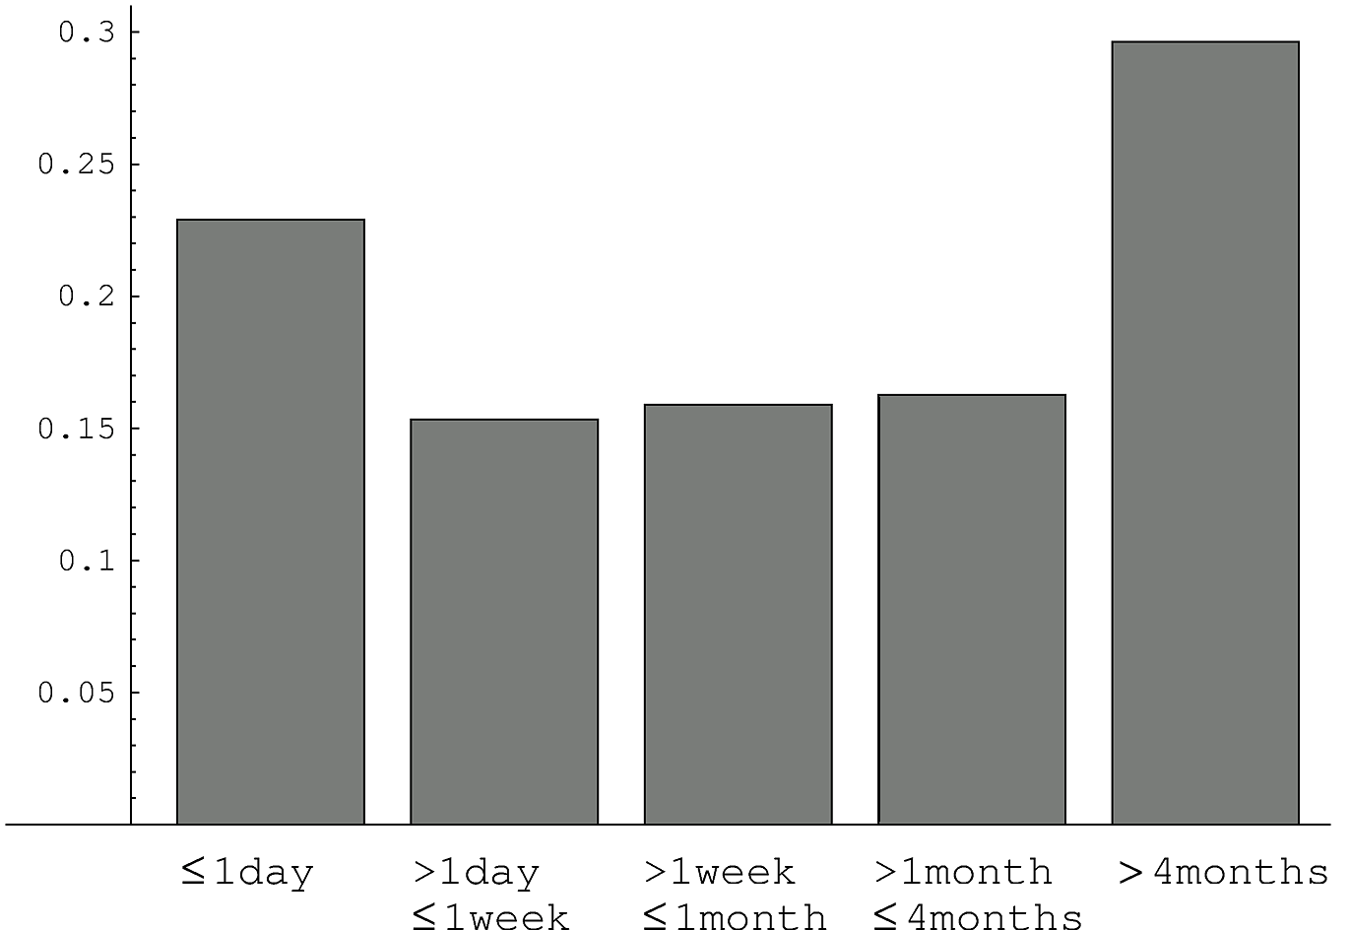
Average Change Interval
fraction of pages

Slide 11
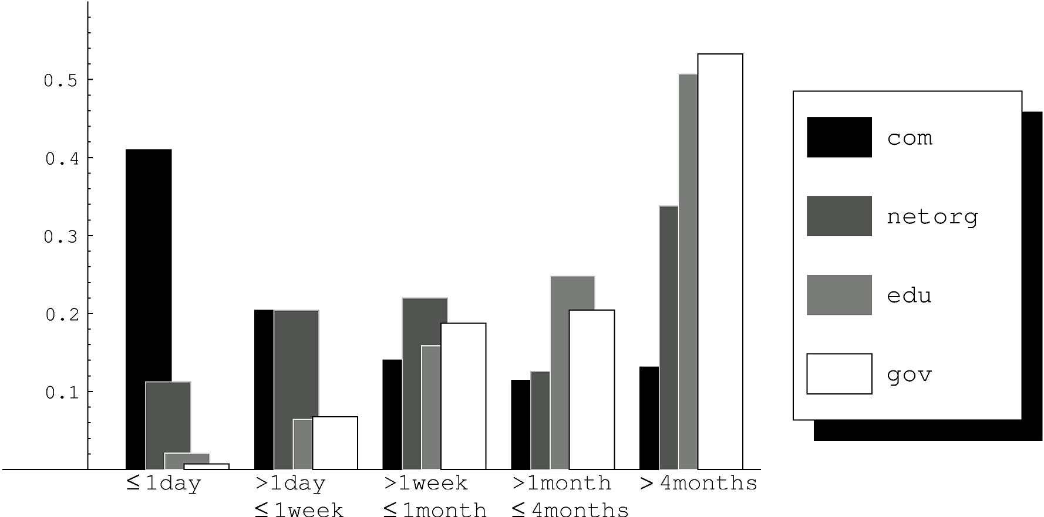
Average Change Interval — By Domain
fraction of pages

Slide 12
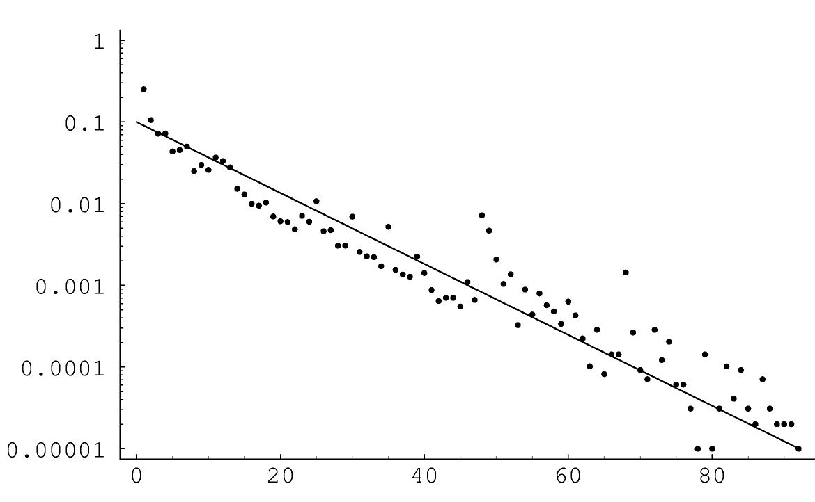
Change Interval of Pages
for pages that
change every
10 days on average
fraction of changes
with given interval
Poisson model
interval in days

Slide 13
Poisson Model
Seems to be good for the pages whose change frequencies are in the range of once every week through once every month
The range can could be verified using the available dataset
Q: But Is the Poisson model correct in general?

Slide 14
Question on Poisson Model

Slide 15
Back to Page Refresh Policy as Optimization Problem
Given pages $p_{1},p_{2},…, p_{n}$ whose changes follow Poisson processes of rate $λ_{1},λ_{2},…, λ_{n}$, respectively, find a “refresh policy” that maximizes the time-averaged freshness (or age) of the collection $C$: $\overline{F}\left(C\right)=\frac{1}{n}\sum_{i=1}^{n}{\overline{F}(p_{i})}$
Q: What is the “refresh policy”? What things do we need to decide for a “page refresh policy”?

Slide 16
Refresh Policies
Refresh order
In what order?
Refresh frequency
How often to refresh?
Refresh points
Exactly when to refresh?
Resource allocation
How often each page?

Slide 17
Refresh Order
Fixed order
Example: Explicit list of URLs to visit
Random Order
Example: Start from seed URLs & follow links
Purely Random
Example: Refresh pages on demand, as requested by user
Let us assume that all pages change at the same rate $λ$, we refresh pages at the same rate $f$ and see how freshness (or age) change depending on the choice of refresh order

Slide 18
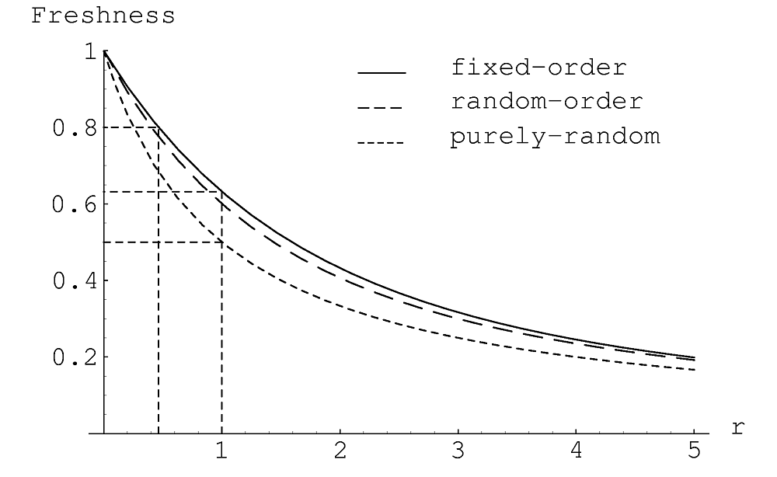
Refresh Order and Refresh Frequency
r = λ / f = change frequency / refresh frequency

Slide 19
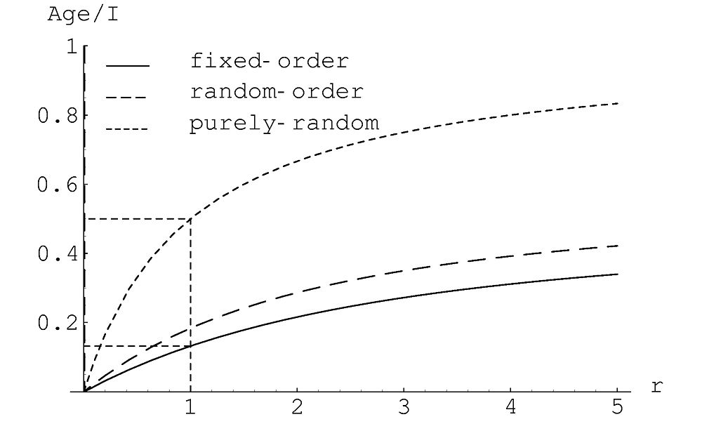
Refresh Order and Refresh Frequency
= Age / time to refresh all N elements
r = λ / f = change frequency / refresh frequency

Slide 20
Refresh Order and Refresh Frequency
Fixed order is optimal
Given change frequency $λ$ and refresh frequency $f$, the time averaged freshness and age are: $\overline{F}\left(C\right)=\overline{F}\left(λ, f\right)=\frac{1−e^{−λ/f}}{λ/f}$ $\overline{A}\left(C\right)=\overline{A}\left(λ, f\right)=\frac{1}{f}\left(\frac{1}{2}−\frac{f}{λ}+\frac{1−e^{−λ/f}}{{\left(λ/f\right)}^{2}}\right)$

Slide 21
Resource Allocation
Two page collection
p₁ changes daily
p₂ changes once a week
Can visit pages once a week
How should we visit pages?
p₁ p₁ p₁ p₁ p₁ p_{1 ...}
p₂ p₂ p₂ p₂ p₂ p_{2 ...}
p₁ p₂ p₁ p₂ p₁ p_{2...} [uniform]
p₁ p₁ p₁ p₁ p₁ p₁ p₁ p₂ p_{1 ...} [proportional]
?
p₁
p₁
p₂
p₂
collection
web

Slide 22
Proportional Often Not Good!
Visit fast changing p₁ ⇒ get 1 day of freshness
Visit slow changing p₂ ⇒ get 1 week of freshness
Visiting p₂ is a better deal!
Q: What is the “best” resource-allocation policy?

Slide 23
Resource Allocation as Optimization Problem
Given change rates $λ_{1},λ_{2},…, λ_{n}$ and average refresh rate $f,$find the optimal individual refresh rates $f_{1}, f_{2},…, f_{n}$ (with $\frac{1}{n}\sum_{i=1}^{n}{f_{i}=f }$)that maximize the time-averaged freshness (or age) of the collection $C$: $\overline{F}\left(C\right)=\frac{1}{n}\sum_{i=1}^{n}{\overline{F}\left(λ_{i}, f_{i}\right)=}\frac{1}{n}\sum_{i=1}^{n}{\frac{1−e^{−λ_{i}/f_{i}}}{λ_{i}/f_{i}}}$
Q: How can we solve the optimization problem?
A: The function has derivatives! Use gradient descent (with lagrange multiplier method to take into account the constraint $\frac{1}{n}\sum_{i=1}^{n}{f_{i}=f}$)

Slide 24
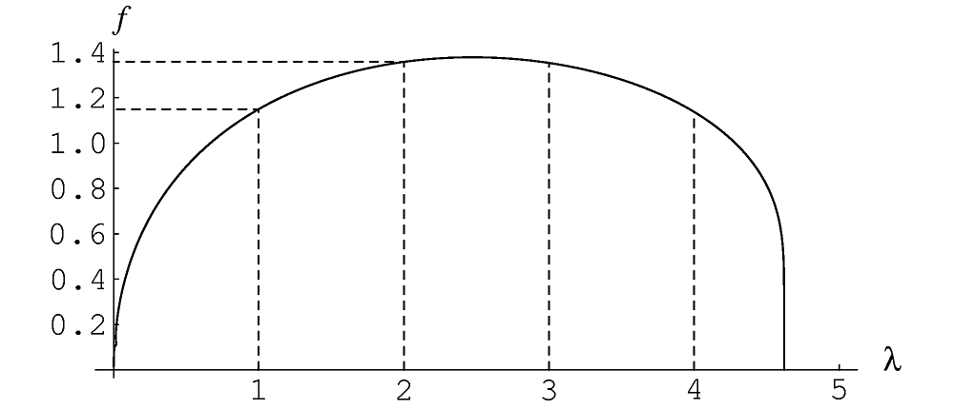
Selecting Optimal Refresh Frequency
Shape of curve is the same in all cases
Holds for any change frequency distribution

Slide 25
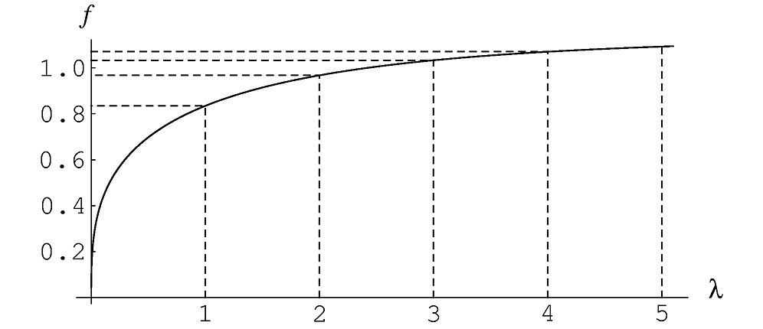
Optimal Refresh Frequency for Age
Shape of curve is the same in all cases
Holds for any change frequency distribution

Slide 26
Proportional vs Uniform
We can mathematically prove that uniform is always better than proportional
Assuming every page changes
Proportional allocates resources to pages that change too often
Proof is based on the concavity of freshness/age curve

Slide 27
Comparing Policies

